Slide 1
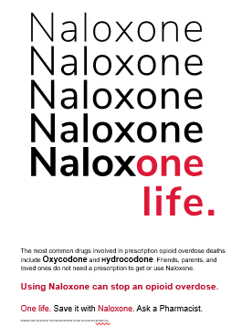
Communicating with Patients about Overdose Risk
Lori Keyser-Marcus, PhD
VCU Department of Psychiatry

Slide 2
Disclosures
None to report

Slide 3
Overdose deaths in Virginia continue to climb
Notes:
The number of drug/poisoning deaths in 2020 increased by 41.8% compared to 2019 (rate of 26.9 and 19.1 per 100,000 persons, respectively)

Slide 4
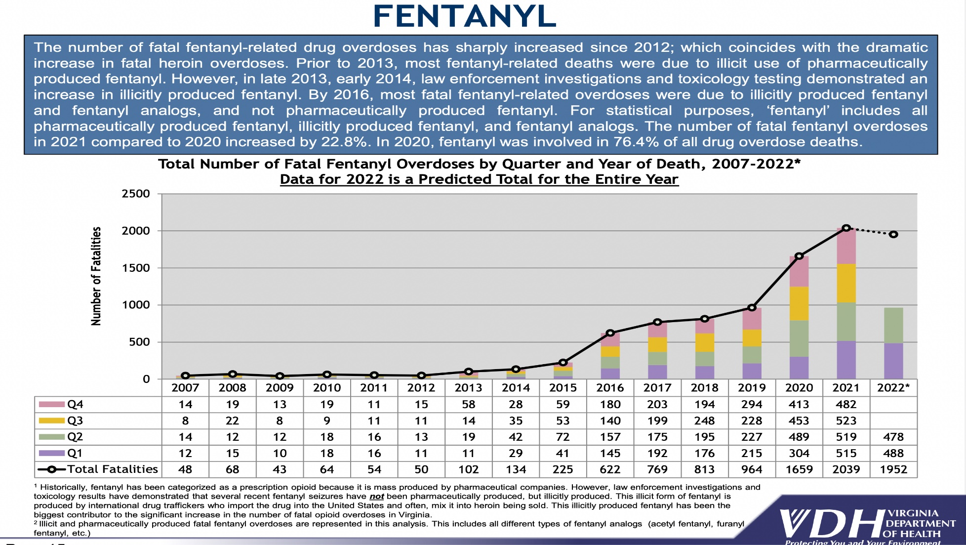
Fentanyl increases risk
Notes:
Fatal fentanyl and/or heroin overdoses surpassed prescription opioid (excluding fentanyl) overdoses in 2015 and this trend continued at a greater magnitude in 2020
In 2020, fentanyl (Rx, illicit, and analogs) was responsible for 71.8% of all fatal overdoses, all substances

Slide 5
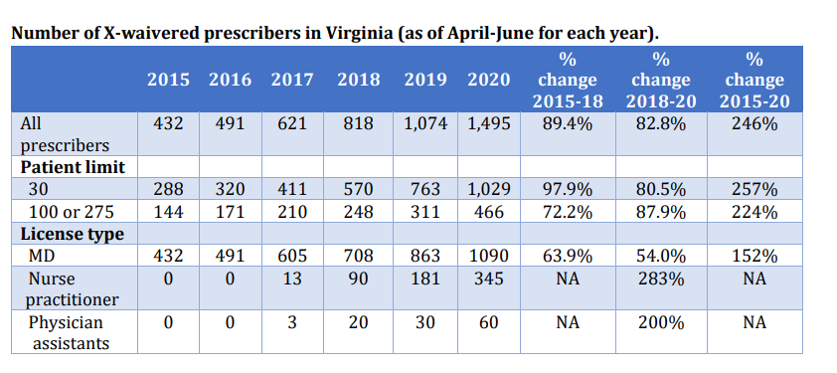
Increased Buprenorphine Prescribers from 2015-2020
Medicaid Expansion and ARTS program in Virginia
Cunningham P, Pierre-Louis S, Saunders H, Britton E, Urmi A, Barnes A. (2022)

Slide 6
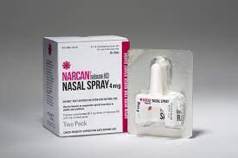
What other strategies are available to combat overdose?
Patient education
(and families!)
Harm Reduction
Ongoing dialogue

Slide 7
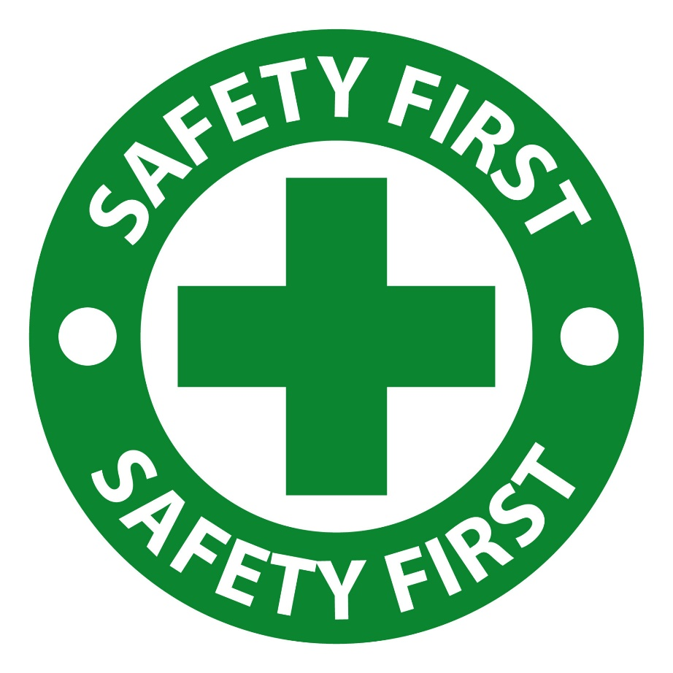
Step 1: Starting the conversation about overdose prevention
Establishes the importance of patient well-being and safety in a nonjudgmental way.

Slide 8
Communicating with patients about risk
Overdose prevention education and naloxone distribution should be provided at treatment entry, as well as making it part of an ongoing discussion at each clinical visit.
Questions about overdose risk can be included at intake and health screenings.
Ongoing discussions of recovery should include possibilities of relapse and overdose risk
Treatment planning should include overdose risk reduction- and an individualized opioid overdose risk reduction plan.
http://prescribetoprevent.org/wp2015/wp-content/uploads/care-principles-guidance-opioid-overdose.pdf

Slide 9
Opening the door to a discussion about overdose prevention
Start by asking permission to explore plans for preventing overdose (e.g, Is it ok if I speak with you a bit about your plans to stay safe?”)

Slide 10
USE YOUR MI OARS to explore concerns
Ask about concerns regarding the risk of overdose (for themselves and others they know).
Listen without judgement- allowing the patient to explore their feelings, experiences, and concerns

Slide 11
Looking backward and moving forward
If concerns exist, ask about previous steps taken to keep themselves (and others) safe.
Discuss what steps they might take to stay safe moving forward

Slide 12
Develop the plan
Ask permission to share additional resources/provide menu of options
Summarize plans and resources discussed so far

Slide 13
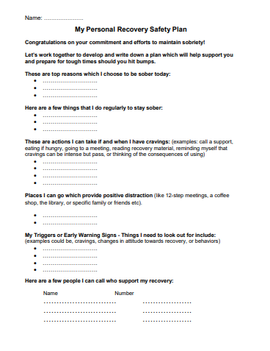
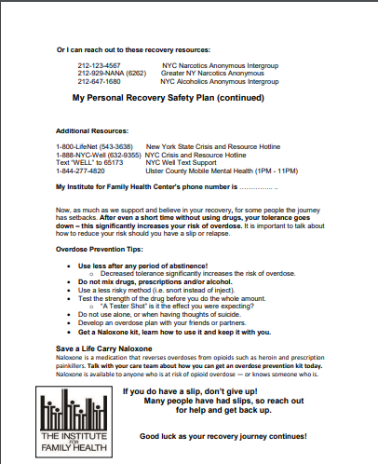
https://drugfree.org/wp-content/uploads/2017/11/Early-Recovery-Substance-Use-Safety-Plan.pdf

Slide 14
Educating patients about risk factors associated with overdose
Mixing Drugs
Tolerance
Quality
Using alone
Age and Physical health
Mode of administration
Previous nonfatal overdose
https://harmreduction.org/issues/overdose-prevention/developing-overdose-prevention-and-naloxone-projects/overdose-response/

Slide 15
Prevention Tips: Tolerance
Use less after any period of abstinence or decreased use
01
If you are using after a period of abstinence, be careful and go slow.
02
Use less when you are sick and your immune system may be weakened.
03
Do a tester shot, or go slow to gauge how the shot is hitting you.
04
Use a less risky method (i.e. snort instead of inject).
05
Be aware of using in new environmentsor with new people as it can increase risk of overdose.
06
https://harmreduction.org/issues/overdose-prevention/developing-overdose-prevention-and-naloxone-projects/overdose-response/

Slide 16
Prevention Tips: Using Alone
USE WITH A FRIEND!
Develop an overdose plan with your friends or partners.
Leave the door unlocked or slightly ajar whenever possible.
Call or text someone you trust and have them check on you.
Have a loaded syringe or nasal naloxone ready.
https://harmreduction.org/issues/overdose-prevention/developing-overdose-prevention-and-naloxone-projects/overdose-response/

Slide 18
Other key items for discussion/ patient education
Recognizing an overdose
Calling 911- Good Samaritan laws
How to use naloxone
Effectiveness of naloxone- opioids can outlast
Getting naloxone REFILLS
Friends/family naloxone training

Slide 19
Integrate Overdose Prevention Messages as Standard Practice
Engage patients in overdose risk conversations
Remind patients who have recently been released from jail or other controlled environment about the increased risk of overdose.
Post overdose messages on fliers or posters-- sends the message that staff is available to discuss overdose risk and response.

Slide 20
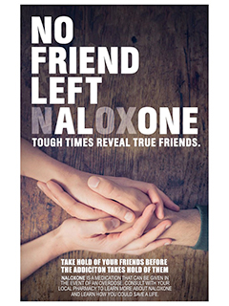
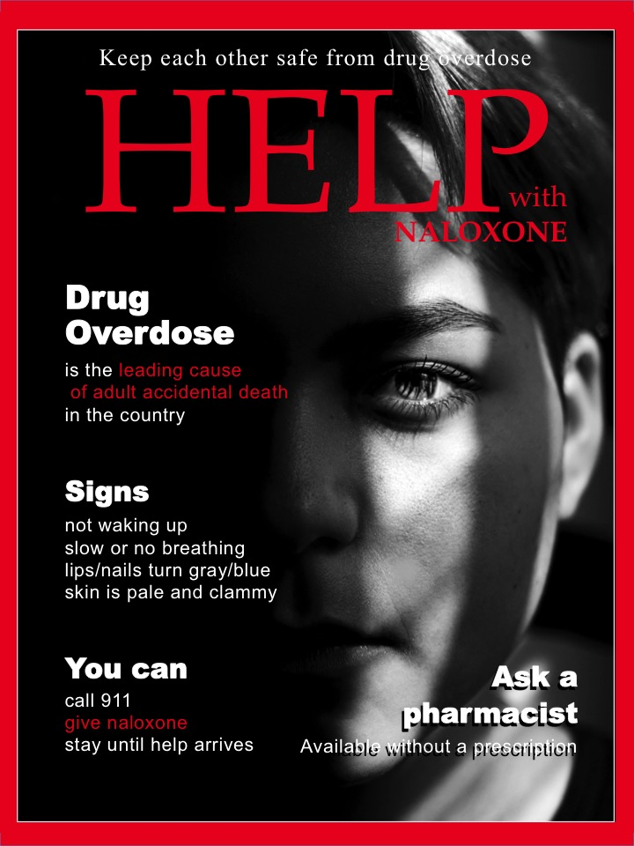
https://prevent-protect.org/community-resources-1/posters/

Slide 22
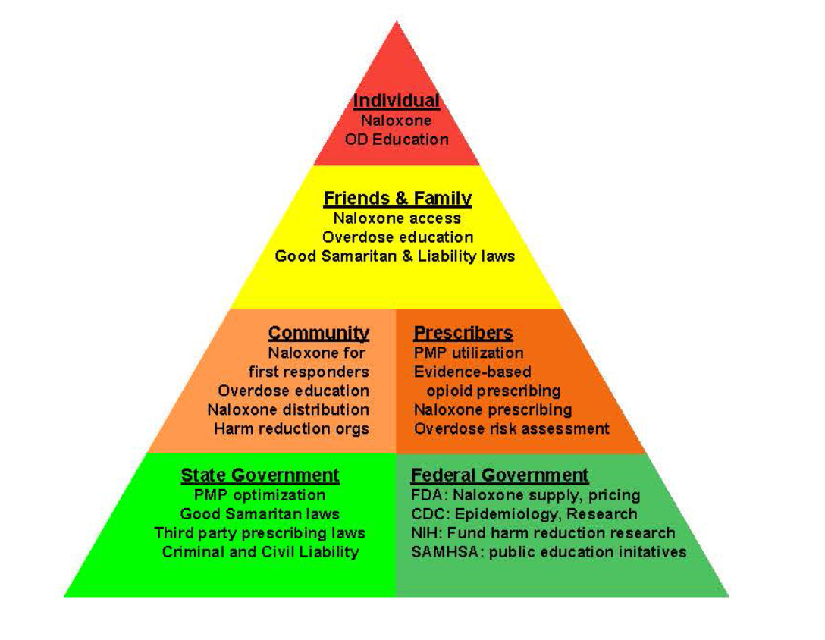
Opportunities to reduce overdose risk through harm reduction strategies.
Multiple access points for initiatives on an individual, friends and family, community, prescriber, and government level.
(Hawk, Vaca, and D’Onofrio, 2015)

Slide 23
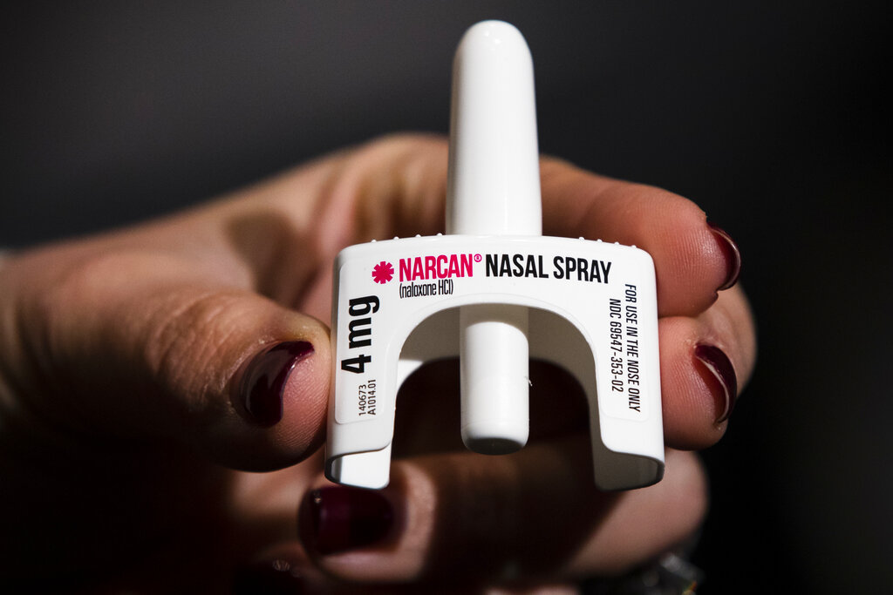
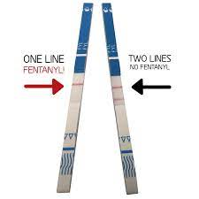
Naloxone and Fentanyl test strips

Slide 24
FREE NALOXONE through VDH/DBHDS
Eligible agencies include:
Community services boards (apply through VDH Office of Epidemiology)
Local health departments
Authorized comprehensive harm reduction sites
Approved naloxone partners
Law enforcement agencies
Fire service organizations
Licensed emergency medical services (EMS) agencies, and
Public schools are eligible to obtain naloxone at no-cost.
Fentanyl test strips are also available for local health departments and approved naloxone partners.

Slide 25
Virginia’s Good Samaritan Law
In 2015 , the “Good Samaritan” overdose prevention statute was signed into law.
This eliminates concern for criminal charges against individuals who seek medical attention for a person who has overdosed.
The reporter must:
Report the overdose directly to a 911 dispatcher, firefighter, EMT or police officer.
Remain at the scene with the person overdosing until emergency personnel arrive.
Identify themselves to the authorities.
Cooperate with any investigation “reasonably related” to the overdose.
The goal is to reduce overdose deaths by protecting the people who call for help.

Slide 26
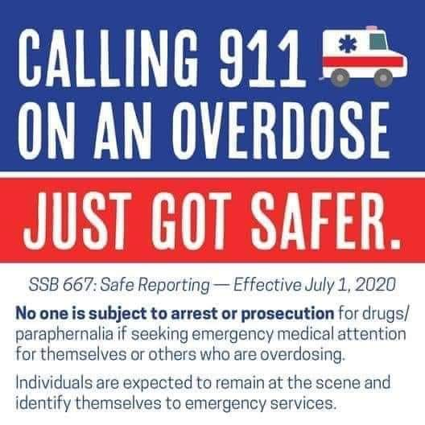

Slide 27
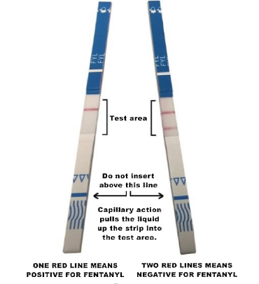
Fentanyl test strips as harm reduction measure
Goal: To allow people who use drugs to check their drug for fentanyl and use that information for drug use decision making.

Slide 28
Does fentanyl test result change drug use?
Sample of 125 people who inject drugs
43% of the sample reported changes in drug use behavior
77% indicated that FTS increased their perceived overdose safety
Using less drug than usual was the most commonly reported change in drug use behavior (32%), followed by per-forming a tester shot (17%), snorting instead of injecting (10%), and pushing the plunger more slowly (9%).
Peiper, Clarke, Vincent, Ciccarone, Kral, Zibbell, 2019

Slide 29
Does preference for fentanyl make a difference in drug use behavior?
Does
Not
Prefer
Prefers
Fentanyl
Morales, Park, Glick, Rouhani, Green, Sherman, 2019

Slide 30
Maryland- Beforeitstoolate.Maryland.gov
PSAs
Harm reduction department (approx. 2019)
Overdose response program
Send teams of peer recovery specialists to high risk area
Send out alerts o subscribers when overdose spikes in certain areas “bad batch”
Every staff member naloxone trained- can hand out naloxone and fentanyl test strips
Go to businesses (e.g., McDonalds) to provide naloxone training and provide naloxone

Slide 31
Questions for you
Has overdose already occurred in your agency? If so, how was it handled?
When is overdose risk currently addressed?
What agency-wide steps are being taken to promote overdose risk discussions?
What overdose prevention tools are you already using?

